Slide 1
Analysis of Quantitative Regression QSAR Models for Predicting Chemical Toxicity
Matthias Rathbun

Slide 2
Introduction

Slide 3
Issues
Regulations to improve safety and animal welfare.
New Products require testing on toxicity.
Computational models reduce need for animal testing.
Computational models take less time than animal testing.

Slide 4
Gaps in Current Knowledge
Model scaling.
Small domain of applicability.

Slide 5
Analysis

Slide 6
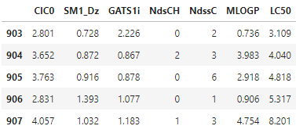
Data
6 molecular descriptors and 1 quantitative response (LC50).
908 Chemicals.

Slide 7
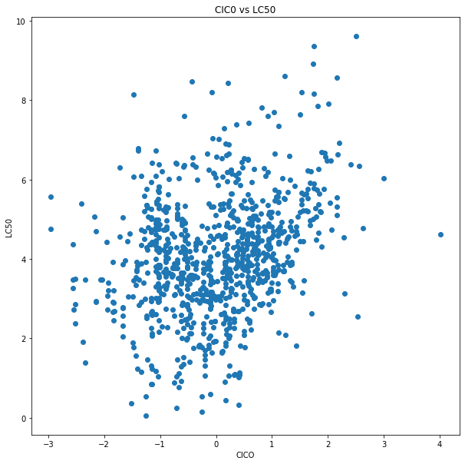
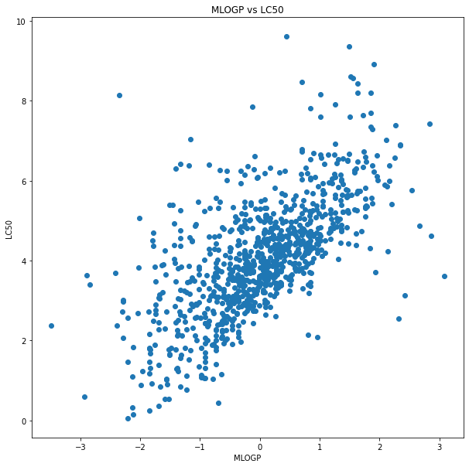
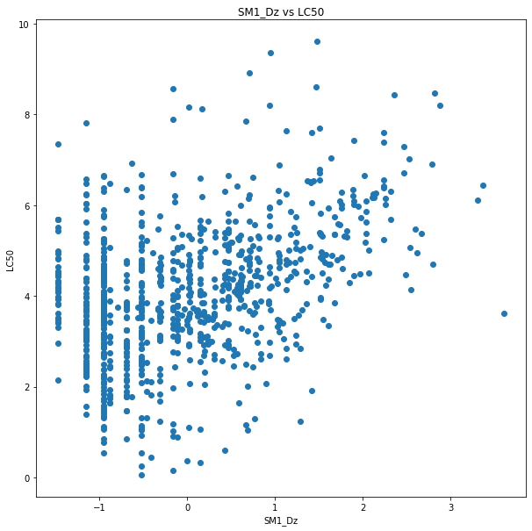
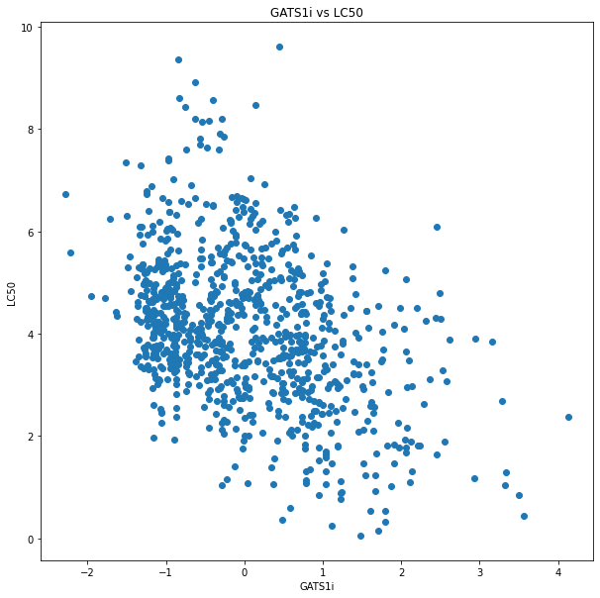
Interesting Trends

Slide 8
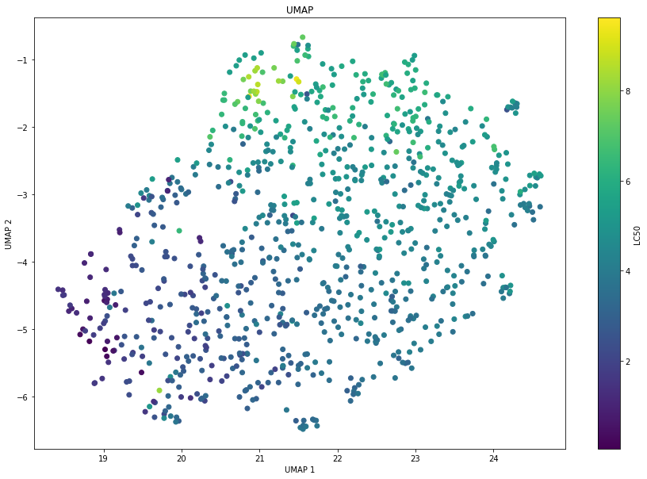
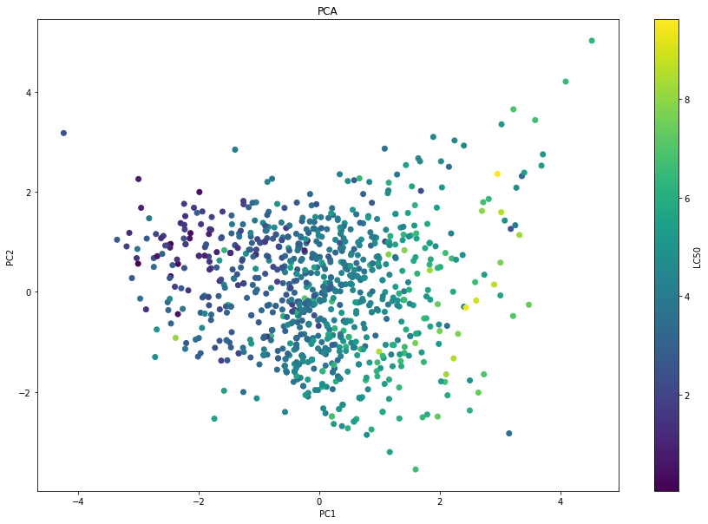
Dimensionality Reduction

Slide 9
Preprocessing
Data normalized using standard scalar.
80/20 Train test split. Test against overfitting.

Slide 10
Modeling

Slide 11
Linear Models
Validation with best linear model led to r² = 0.609.
Interaction terms led to overfitting.
Collinearity not apparent (VIF < 3).
Gradient descent used to minimize cost function.
Handicapped by linearity.

Slide 12
Regularization
Aides with overfitting.
Slight improvement using ridge and elasticnet alogrithms.
Lead to validation r² of 0.620 and MSE lowered by 0.02 pts.

Slide 13
Random Forest
Can learn nonlinear trends.
Decision trees.
Preserves some linearity.
Allows for more detailed optimization.
Validation r² = 0.658.

Slide 14
Deep Neural Network
Similar to decision tree in preserving trends.
More complex, longer to optimize.
Not much improvement over decision tree.
Tendency to overfit.
Validation r² = 0.662.

Slide 15
K Nearest Neighbor
Distance based model.
Better when clusters are present.
Best scaling for this type of problem.
Computationally inexpensive.
Highest validation r² = 0.711

Slide 16
Conclusions & Future Investigations

Slide 17
Conclusions
Data exhibited some clustering (PCA & UMAP).
KNN Has good scaling with new instances.
  The more data, the better clusters form.
Limited number of possible chemicals.
  No need for overly complex model.
    Not testing millions of points, only thousands.

Slide 18
Future Investigations
Cutoff between safe and unsafe chemicals.
Turns into classification problem.
Returns label (safe or unsafe) and confidence.
Only chemicals that model is highly confident in being safe pass.
Distance Thresholding.
  Increases regression performance.

Slide 19
Questions

